Slide 1
Grid Energy Storage
New England Electricity Restructuring Roundtable
Andy Chu
VP, Marketing & Communications
A123 Systems

Slide 2
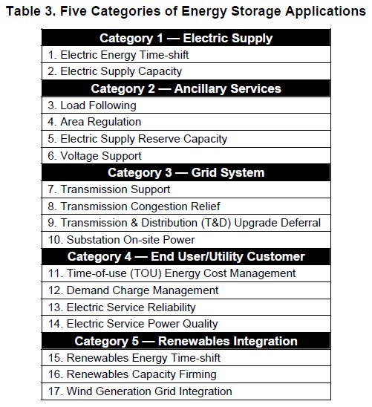
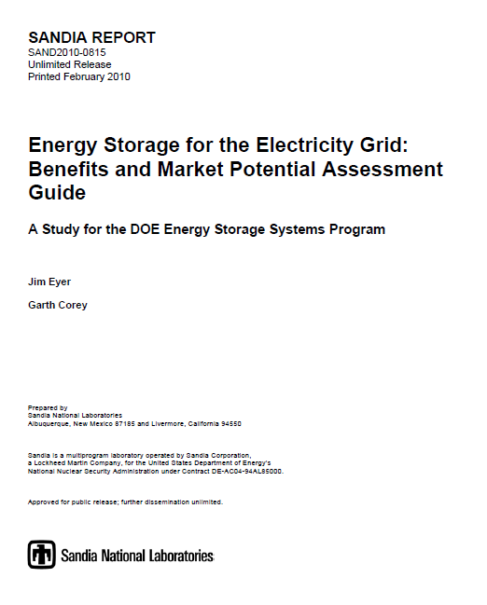
Sandia Energy Storage Report

Slide 3

Total USA Storage Market
Potential = >$22B/year
9,000
3,500
8,000
3,000
7,000
6,000
2,500
5,000
2,000
Market Potential $M/yr
Economic Value ($/kW)
4,000
1,500
3,000
1,000
2,000
1,000
500
-
-
Potential Benefit ($/kW)
Potential Market ($M, 1 yr)
Source: Sandia Report: SAND2010-0815 February 2010

Slide 4
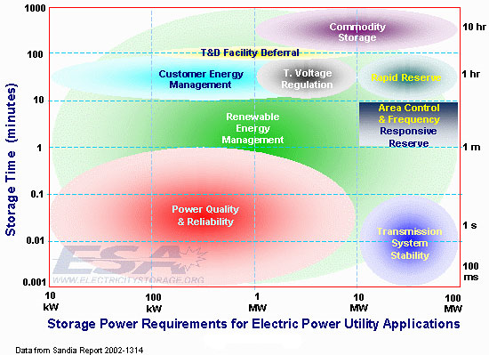
Requirements for Utility Applications

Slide 5
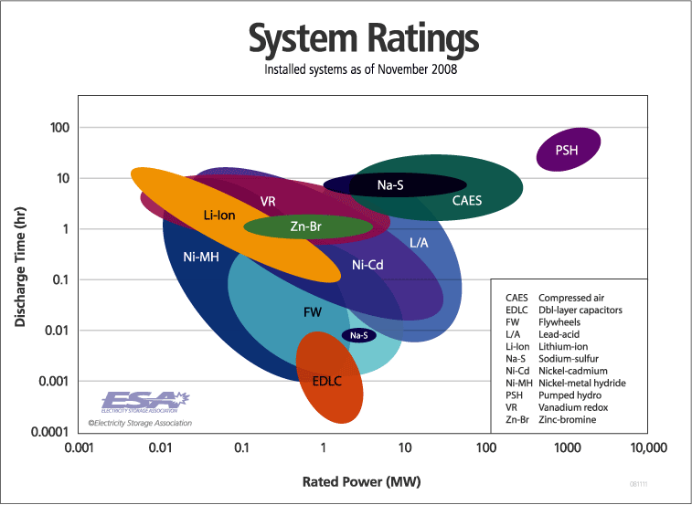
Energy Storage Technology Comparison
Li-ion

Slide 6
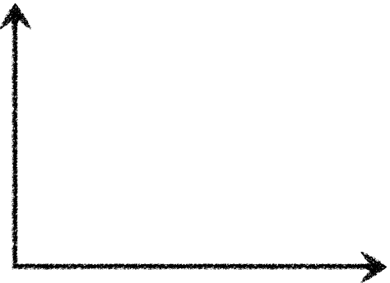

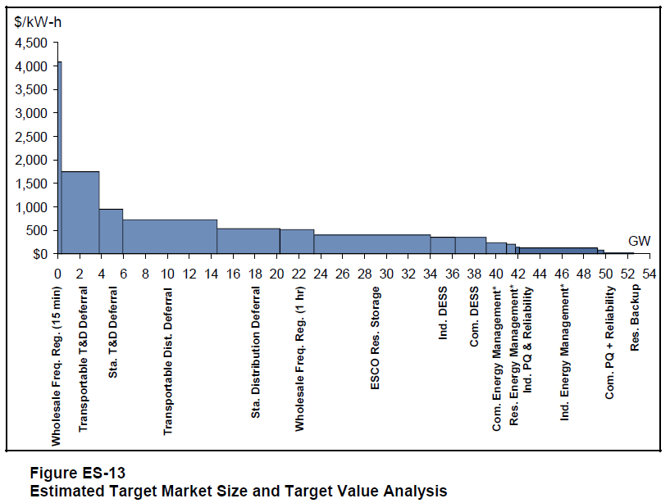
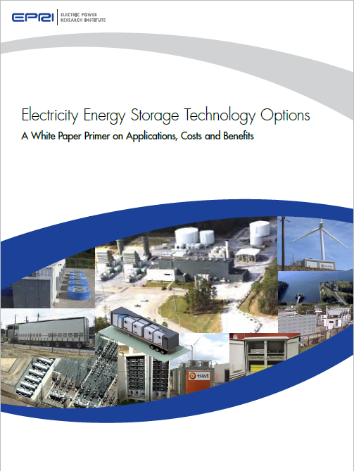
EPRI Grid Energy Storage Market Size
Ancillary (Power) Services
Value
Area Control
$$$/MWh
Ancillary services:
Majority of A123’s
business to-date
Frequency Regulation
Spinning Reserve
Bulk Energy
Renewable Energy Management
Transmission & Distribution
Peak Shaving
New applications
opened up by lower-
cost systems
Seconds Minutes Hours Days

Slide 7
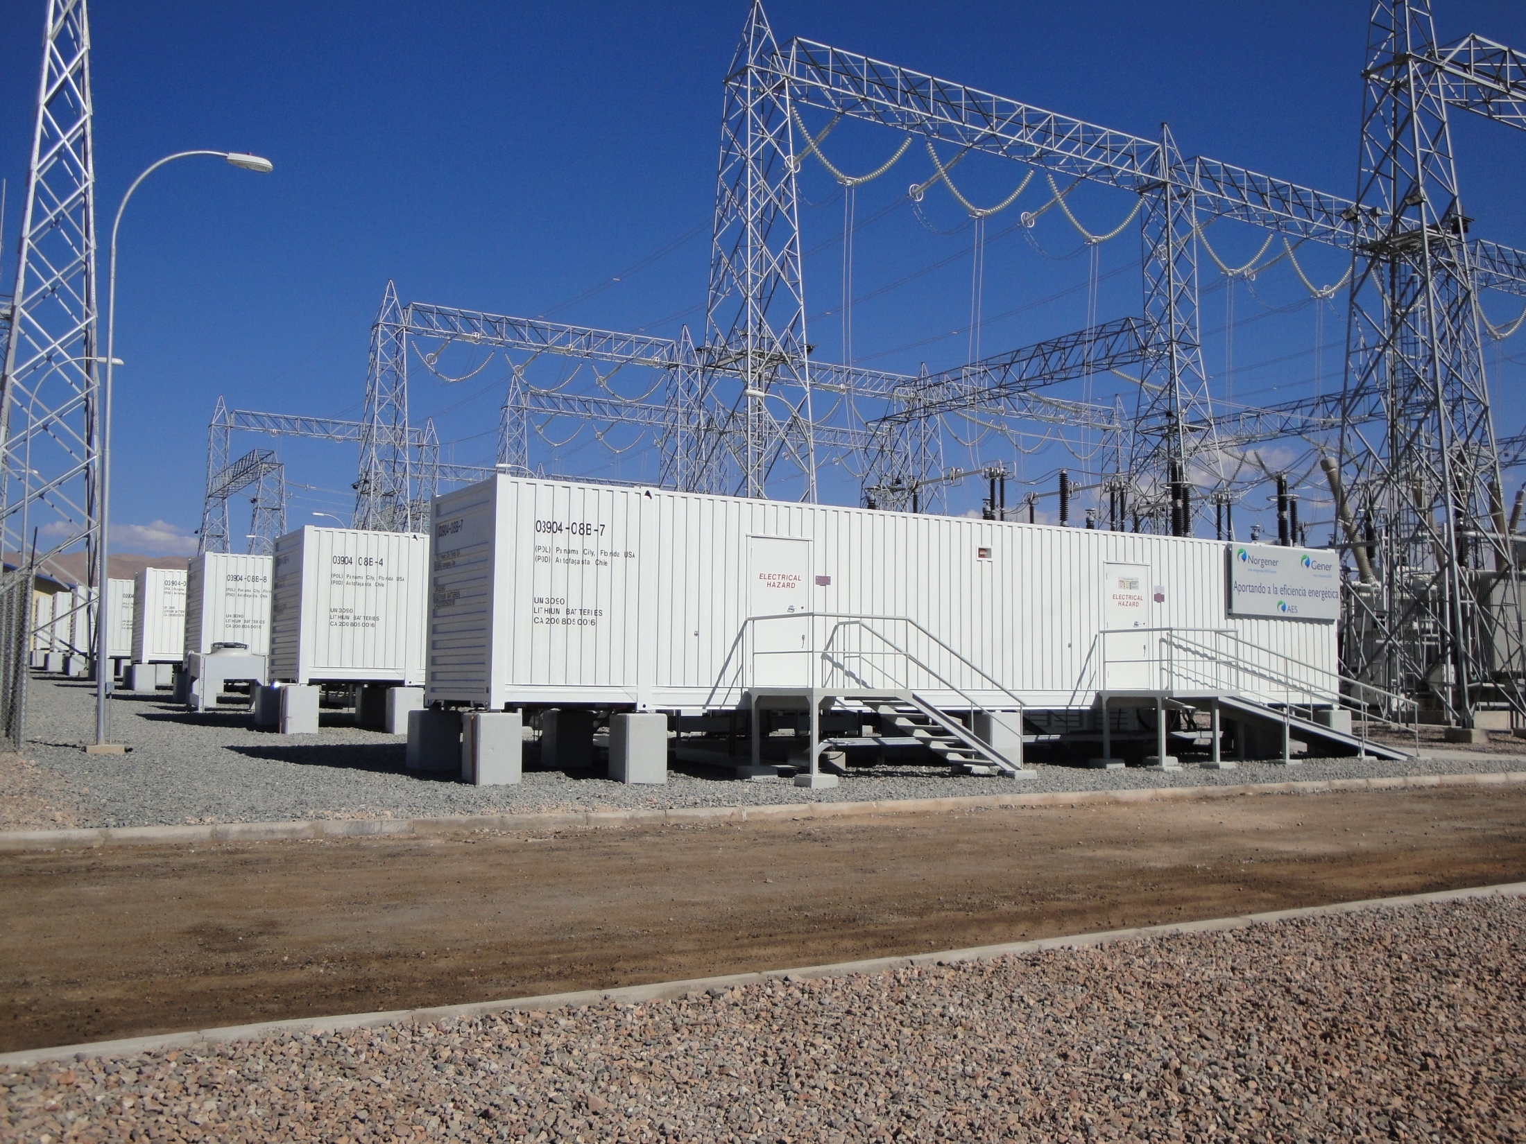







A123 is Well-Positioned in Grid Energy Storage
A123 is the #1 producer of lithium ion batteries for the grid
  Approaching 100 MW installed by end of 2011
  AES: >500MW projects in its pipeline
A123 expanding product portfolio
  Adding multi-hour system, expands potential applications/customers
  32 MWh Tehachapi project under construction with Southern California Edison
Independent Power Producers
Utilities
Partners
Hardware

Slide 8
Sanyo Says Lithium-ion Battery Market May Triple in 10 Years
http://www.businessweek.com/news/2010-11-17/sanyo-says-lithium-ion-battery-market-may-triple-in-10-years.html
November 17, 2010, 11:46 PM EST
By Mariko Yasu
Nov. 18 (Bloomberg) -- Sanyo Electric Co. expects the global lithium-ion battery market will more than triple to 5 trillion yen ($60 billion) in 10 years, driven by demand from power companies and electric cars.
“Power companies in the U.S. are likely to install more energy storage systems to boost demand for rechargeable batteries,” Mitsuru Honma, head of Sanyo’s energy business, told reporters in Tokyo today.
Batteries for large-scale power storage systems will grow to at least to 2 trillion yen globally, while those used in environment-friendly cars will probably total 1.5 trillion yen, Honma said. Consumer electronics will account for the remaining 1.5 trillion yen, he said.
Global shipments of the power cells will probably total 1.5 trillion yen in the year ending March 2011, Honma said.
Sanyo predicts grid energy storage will exceed transportation

Slide 9

Energy storage is the key
Advances in battery technology are enabling new applications
Power
Industry
Auto
Industry
EV
PHEV
Grid
Energy
Storage
HEV
Battery
Industry

Slide 10
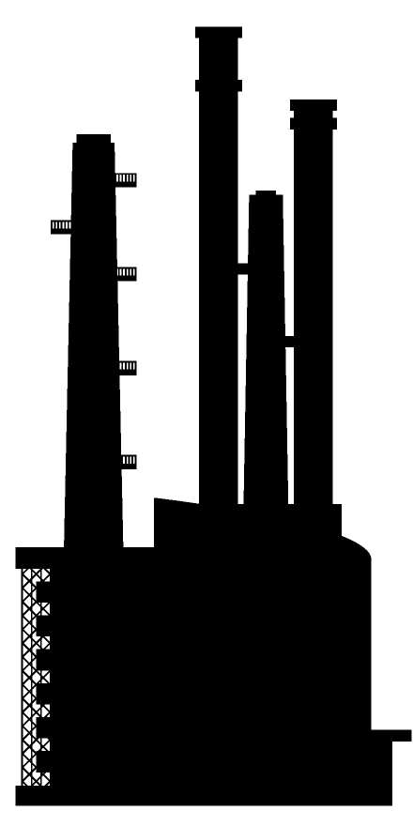

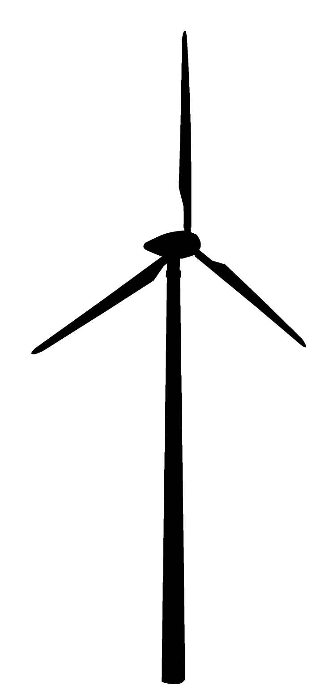



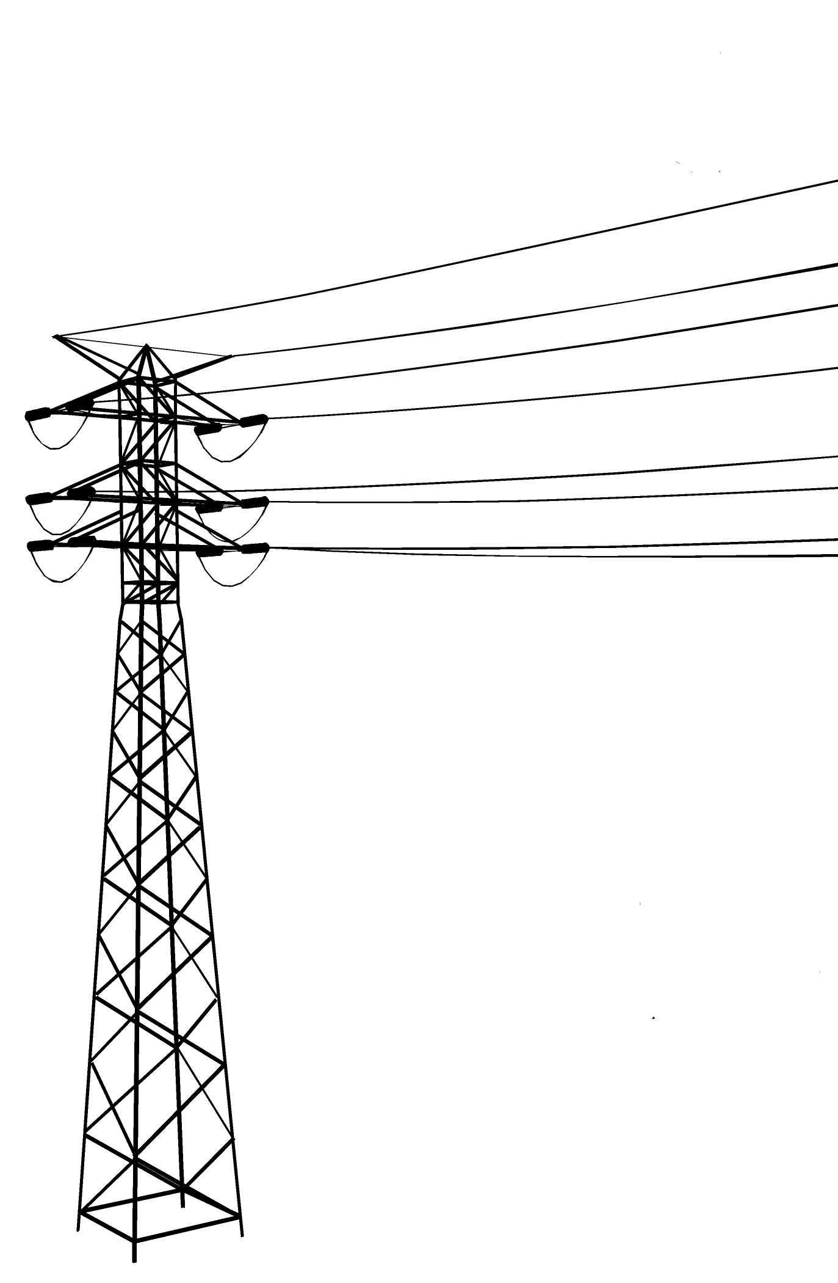




Energy Ecosystem
Grid-scale
energy storage
PHEV, E-REV, EV

Slide 11

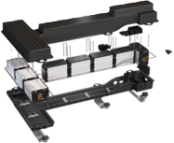
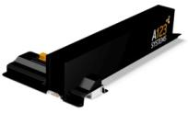
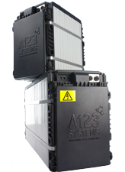
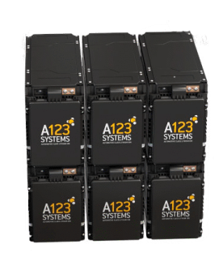
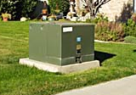
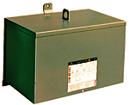
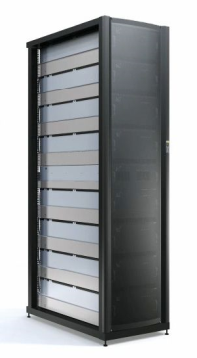
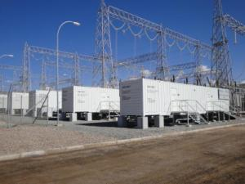
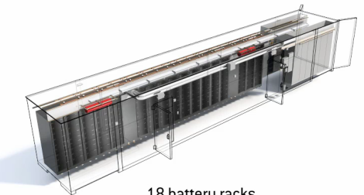
Synergies Between Grid and Transportation
Economies of scale, speed to development and deployment

